Slide 1
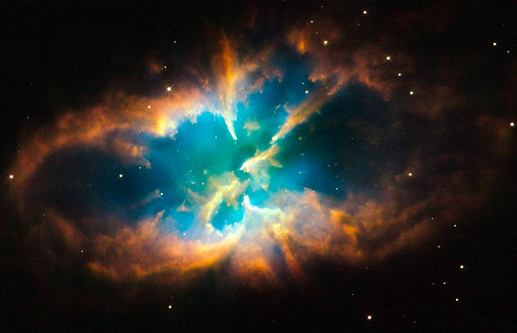
In The Beginning

Slide 2
In the beginning Elohim created the heavens and earth.
What is the untranslated word?
Why is the Bet bolded?
What do the letters of Bereshit mean?

Slide 3
Who or what is the Aleph Tav?
Aleph and Tav are the first and last letters of the Hebrew Alephabet
Aleph – Strong or strength of
Tav – Sign or beacon
Aleph Tav grammatically indicates the action of the verb is on the object and not on the subject.
Could it be referring to anyone or anything else?

Slide 4
Aleph Tav
John Chapter 1:
“In the beginning was the Word and the Word was with God, and the Word was God, He was with God in the beginning. All things came to be through him, and with out him nothing made had being. In him was life, and the life was the light of mankind. The light shines in the darkness, and the darkness has not suppressed it.”

Slide 5
Aleph Tav
Revelation Chapter 1:
“I am the Alpha and Omega, the Living One. I was dead, but look! – I am alive forever and ever!”
Revelation Chapter 1 actually says:
“I am the Aleph and Tav, the Living One. I was dead, but look! – I am alive forever and ever!”

Slide 6
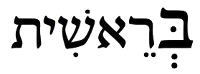
Let’s take a look at the first word
Bereshit

Slide 7
Let’s take a look at the first word
Bet
House
This is the first Jot and Tittle in the Torah. Matthew 5:17-18
Because this letter is bolded, it is saying it is the greatest meaning of the word.
The House of God.
How does a man create a home?

Slide 8
Let’s take a look at the first word
Resh
First, first born

Slide 9
Let’s take a look at the first word
Bar
Son

Slide 10
Let’s take a look at the first word
Bara
Create(s)

Slide 11
Let’s take a look at the first word
Reshit
Beginning, First fruits, or Foremost

Slide 12
Let’s take a look at the first word
Ash
Fire, consuming fire (source of light)
Deuteronomy 4:24

Slide 13
Let’s take a look at the first word
Shin
Protector of the door
Beginning of the Hebrew word Shaddai which means Almighty
Almighty God

Slide 14
Let’s take a look at the first word
Yud
Hand
Notice the way it is seated next to Shin (Almighty God)
Facing you, it is to the right
Possibly referring to the right hand of God

Slide 15
Let’s put it all together
There will be a first born Son, who is foremost; He will build the House of God by taking a bride; He is a consuming fire, Almighty God, and He sits at the right hand God!!!

Slide 16
Another Jot and Tittle
Genesis 2:4
“Here is the history of the heavens and the earth when they were created. On the day when Adonai, God, made earth and heaven.”
They letter Hey has been made small. Hey means reveal. The letter Hey is used in the Torah to add glory. This could be indicating that the glory was diminished on day 2, buy why?

Slide 17
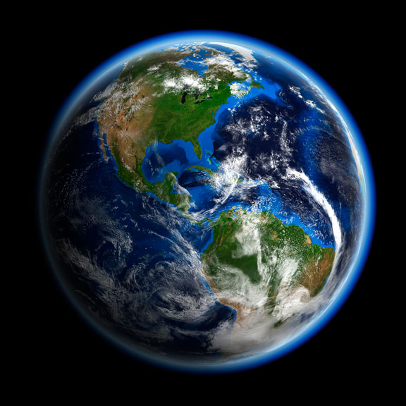
Raqiya - Firmament

Slide 18
Adam and Havah
The Hebrew word for “man” is Adam. This was not a given name, it is derived from the Hebrew word for earth - Adamah.
There are 4 word in Hebrew for earth:
Erets – Used in reference to earth during the spring
Tevel – Used in reference to earth during the summer
Adamah – Used in reference to earth during the fall
Archa – Used in reference to the earth during the winter
This leads us to believe that creation took place in the fall. Also the time of Rosh Hashanah which is the start of the new year. Foreshadowing of the Messiah in the later years.
Side note: Woman in Hebrew is Ishah which is derived from the word for man – Ish
Her given name, Havah, means life because she was the mother of all living

Slide 19
Is there a prophetic meaning in the days of creation?
Theme for each day | Correlation to 1000 year period
1 – Light and Darkness | 0-1000 – Adam brought darkness into the light
2 – Waters | 1000-2000 – Noach and the flood
3 – Plants yielding seed | 2000-3000 – Abraham, Isaac, Jacob and decedents
4 – Lights and Luminaries | 3000-4000 – Kings and prophets
5 – Living Creatures | 4000-5000 – Messiah made us new creatures
6 – Man and Woman | 5000-6000 – Fill the earth and subdue it
7 – Rest | 6000-7000 – Millennial Kingdom with Yeshua

